Slide 1
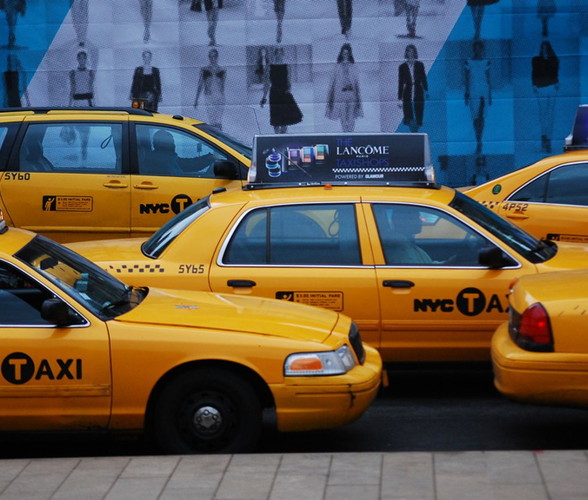
New YORK TAXI DATASET
Álvaro Santamarina
Jaime Municio
Alejandro Vilela
Aristeo Luis Lopez

Slide 2
OUR DATASET basic information
VendorID
Pick up date & time
Passenger Count
Trip Distance
Pick up coordinates: longitude and latitude
Drop off coordinate longitude and latitude
Payment Type
Fare amount
Extra charges
Tip amount
Metropolitan Transportantion Authority tax
Tolls paid
Total amount charged to passengers

Slide 3
What we do want ?
What for ?
We aim to analyze taxi data by areas.
Use interactive maps to showcase the information.
Try to find more optimal ways of performing the current bussiness ventures.
Explore new bussiness oportunities.
To make our information understandable to people without knowledge.
Make more profit with the current bussiness activities.

Slide 4
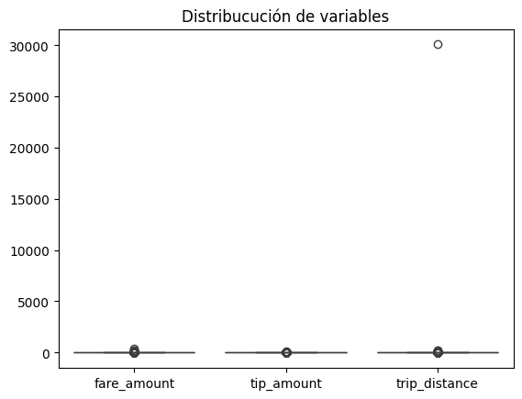
Data depuration EXAMPLES
Examples of filters used to clean the data:
Cliente | Latitud Inicio | Longitud Inicio | Latitud Fin | Longitud Fin
John Smith ID 5678534 | 40,76 | -73,99 | 55,76 | 37,62
Cliente | Latitud Inicio | Longitud Inicio | Latitud Fin | Longitud Fin | Tiempo (min) | Trip Distance
Mark el veloz ID 754567 | 40,76 | -73,99 | 40,76 | -73,99 | 1,26 | 4
1.26 min=1.26​/60 h≈0.021 h
Velocidad=0.021 h 4 km​≈ 190.48 km/h

Slide 5

Data depuration main problem
!!!!49.876.785!!!!
Rows of data

Slide 6
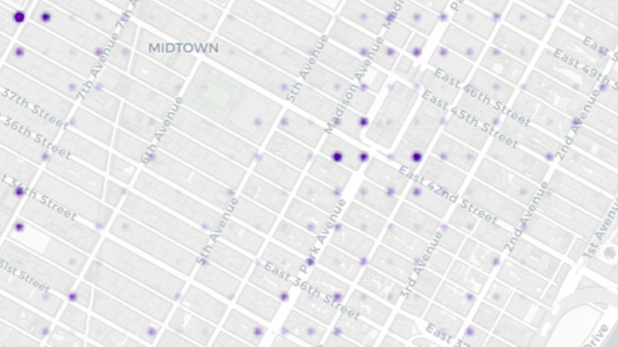









Slide 7
https://aristeo2.github.io/NYCTaxi/
TAKE A LOOK AT OUR WEB PAGE!!

Slide 8


Slide 10

Conclusion
The taxi business in the Manhattan area is very dependant on nightlife, with trips soaring around that time.
People are very concentrated around points of interest & touristic destinations within the city.
Areas with the highest fares on average are not the most congested, mainly because this peaks happen around the afternoon due to work hours.
With this information...
We have the knowledge of how to have a higher profit if you are taxi driver/company
We now can use this data for other posible bussiness ventures

Slide 11
A LOT OF IMPROVEMENTS CAN BE MADE
Three examples of to where you can expand this project further:
GPS to automatically redirect a taxi driver to a zone with a higher probability of obtaining a customer.
If you mix this with metro and bus data, you can make a population map to where people go.
You can use this information to predict where to stablish other bussiness like nightclubs etc.

Slide 12
What have we used
Python
Pandas
Seaborn
Matplotlib
SkLearn
API – Mapbox
Used to upload maps on the web.
Power BI
Used to get insight of our clean data.
Office Package
Powerpoint
Word

Slide 13
Roles of the team
Álvaro
Jaime
Aristeo
Alejandro
PowerPoint Lead
Made the presentation and helped with data depuration.
Documentation Lead
Tasked with the documentation and gave insights.
Python Lead
Created data graphs with Python and cleansed the data.
Power BI Lead
Used Power BI for clearer data visualization.

